Slide 1


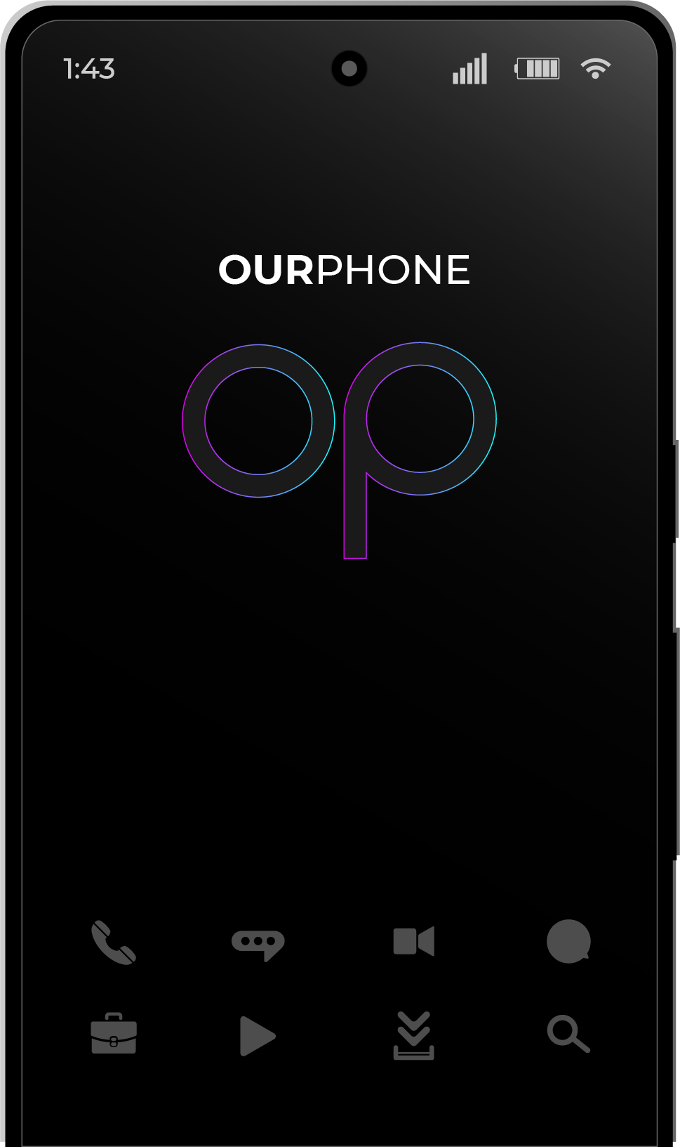
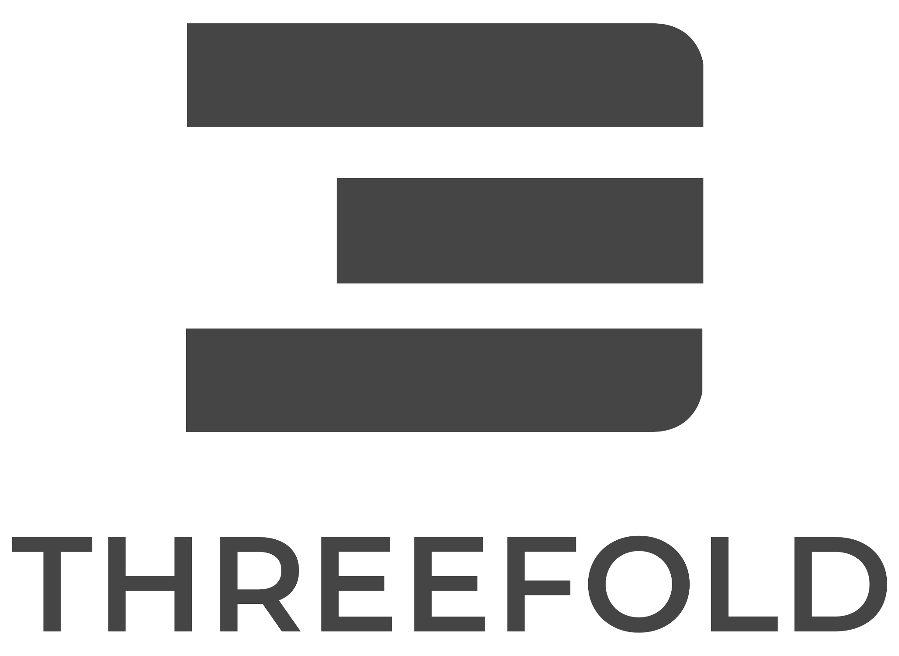
ULTIMATE
SOVEREIGNTY
secure every click with the world’s first truly decentralized mobile phone.

Slide 2
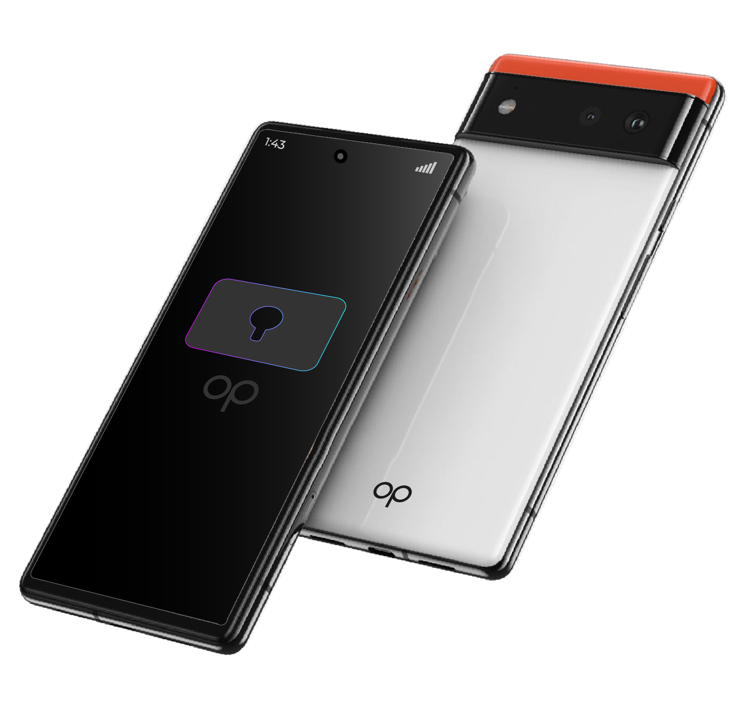
SECURE EVERY CLICK
Every inch of every application is fully encrypted on the OurPhone. Have no concerns about your data being manipulated or stolen.

Slide 3
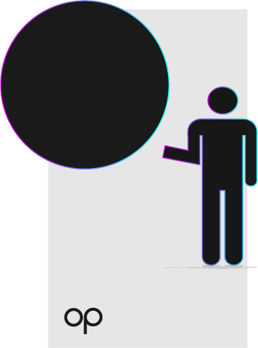
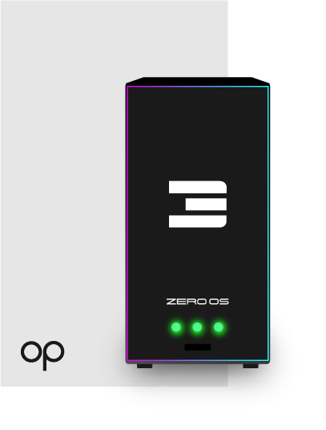

OWN YOUR DATA
QUANTUM SAFE STORAGE
FULLY LOADED
Only you are the sole owner of your data and not large tech companies.
When you subscribe to the OurPhone applications, you automatically receive gigantic decentralized storage space.
The OurPhone already comes with numerous applications and more are becoming available very soon.

Slide 4
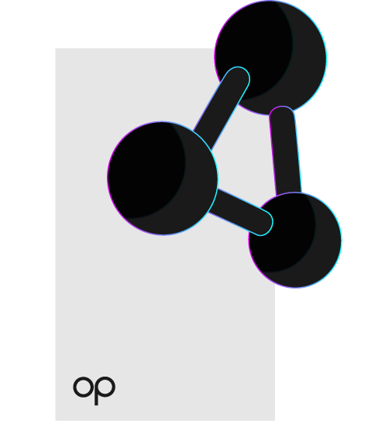
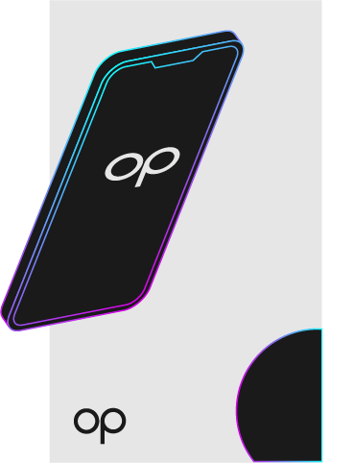
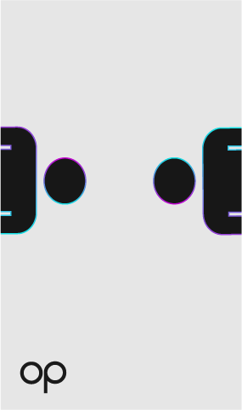
PLANETARY SECURE CONNECTIONS
DECENTRALIZED
ACCESS EDGE COMPUTING
Every application on the OurPhone is hosted on a decentralized network.
Experience unparalleled speeds due to the latest edge cloud technology.
Any transfer of data or communication between parties is completely private and fully secure.

Slide 5
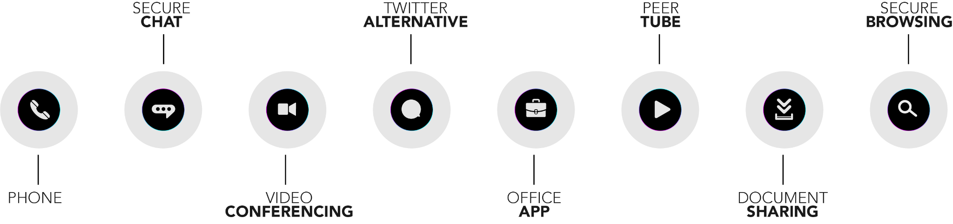
FULLY SECURE & PRIVATE APPS
An abundance of features and applications are available to you.

Slide 6
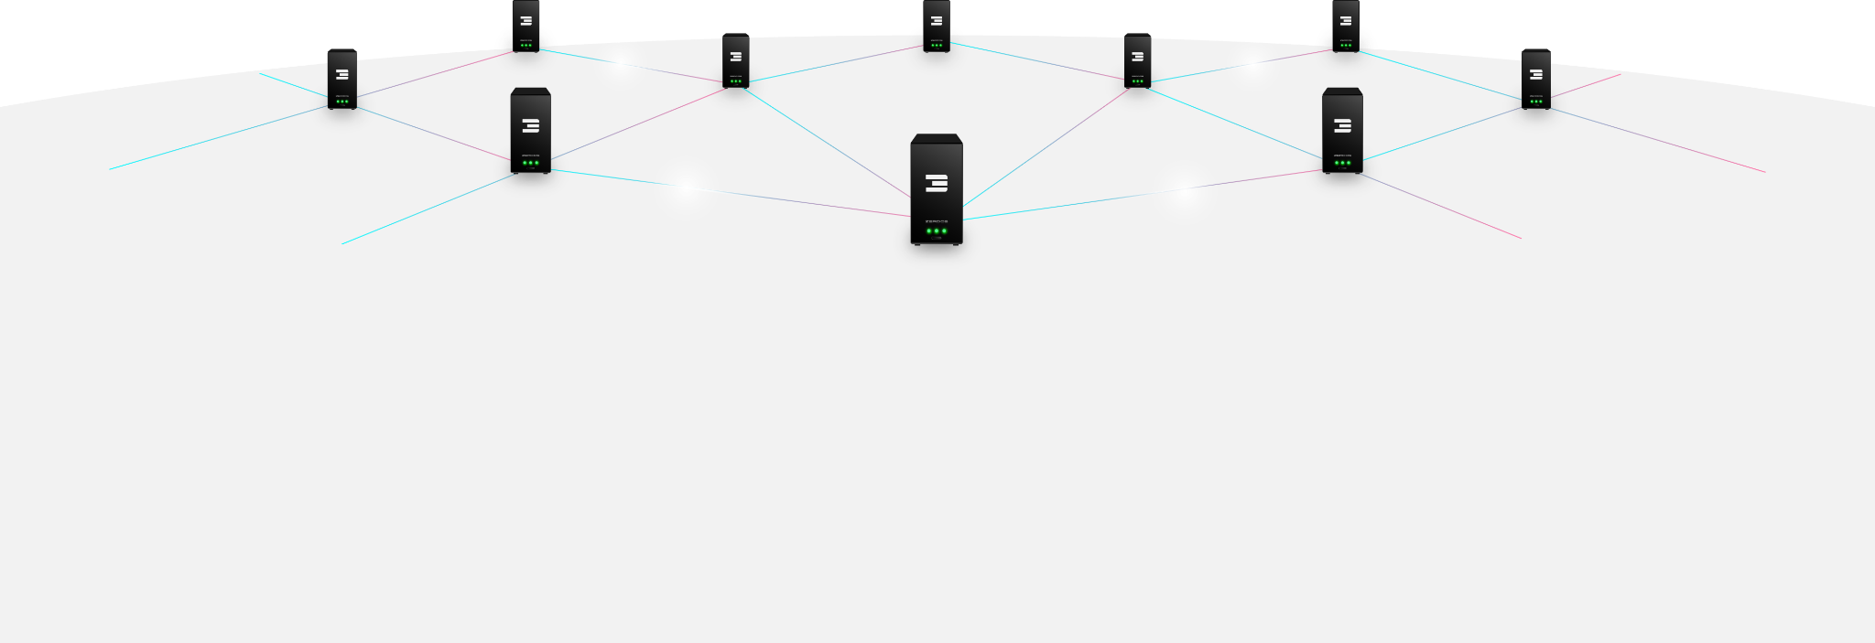
POWERED BY THREEFOLD
The world’s largest decentralized network by ThreeFold allows every application on the OurPhone to attain a level of security and privacy never seen before.
https://www.threefold.io/

Slide 7
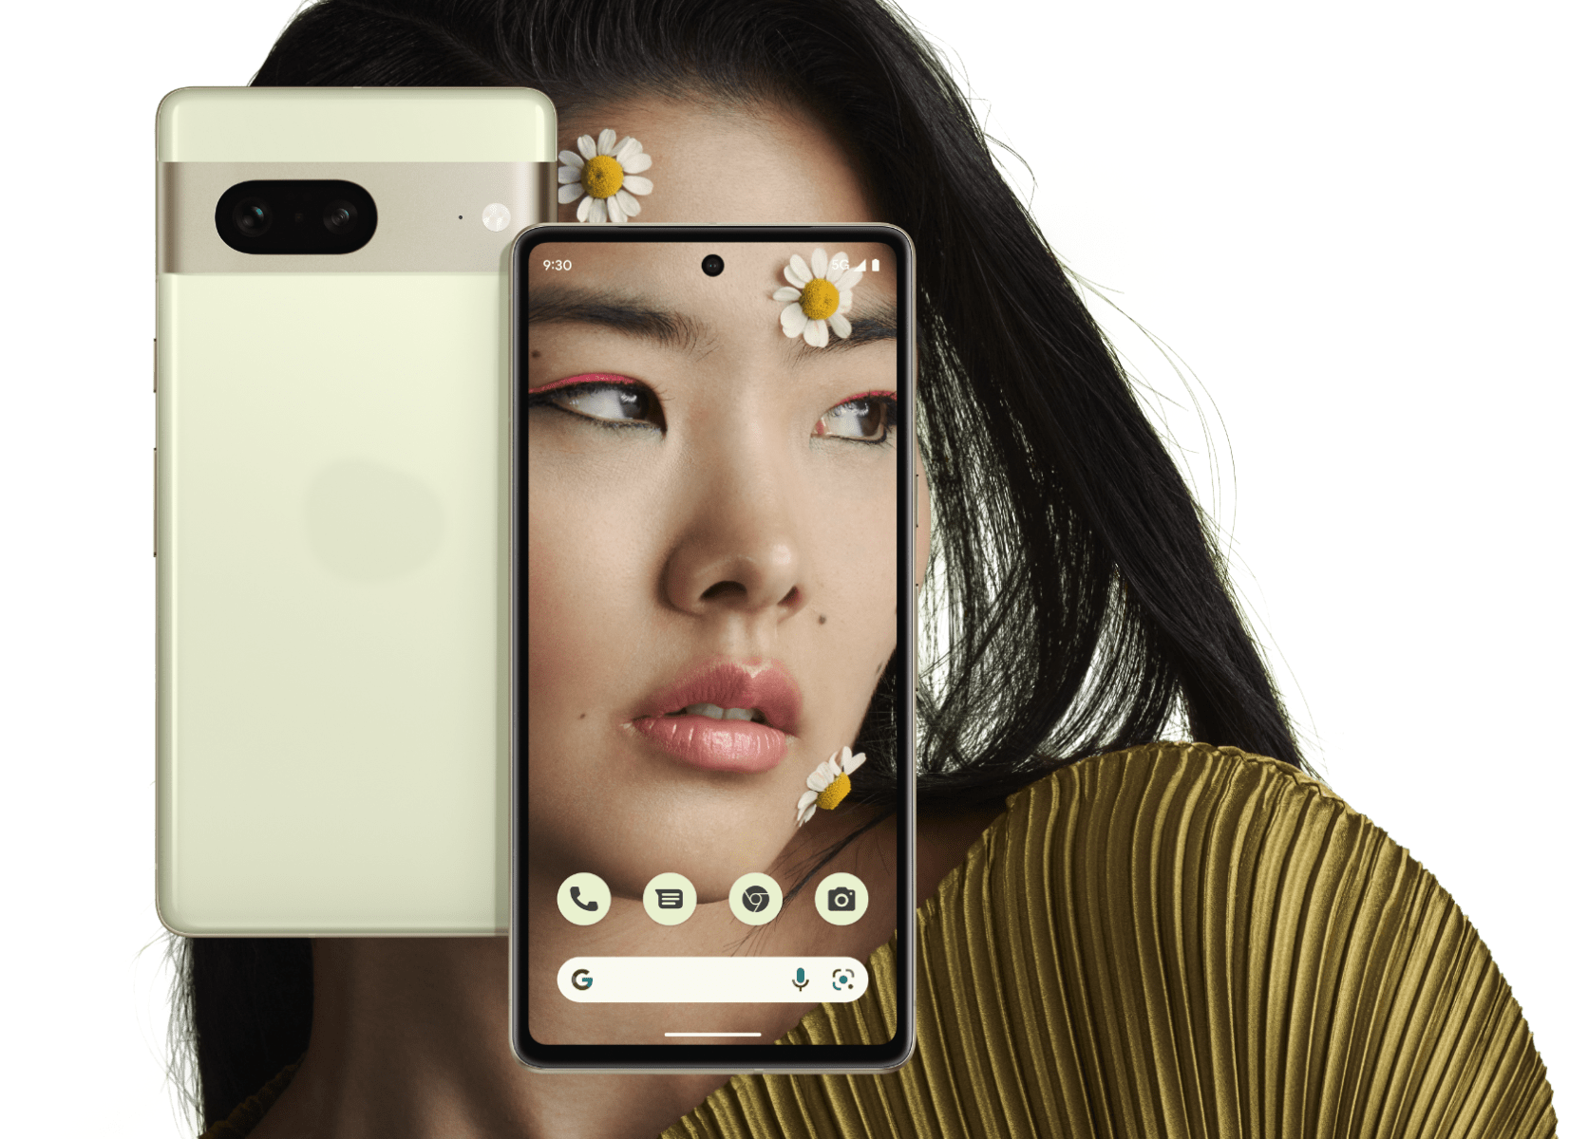
OURPHONE
Based on Google Pixel 6a, 7 and 7 Pro
Super powerful hardware platform.
Graphene OS (Android without Google)
ThreeFold Quantum Safe Storage System
ThreeFold Planetary network
ThreeFold Edge Compute
OurVerse Platform (federated alternatives on twitter, whatsapp, zoom, facebook, youtube, soundcloud, protonmail, …)
FreeFlow Twin (digital twin technology)
Secure compatibility layer with Android apps

Slide 8
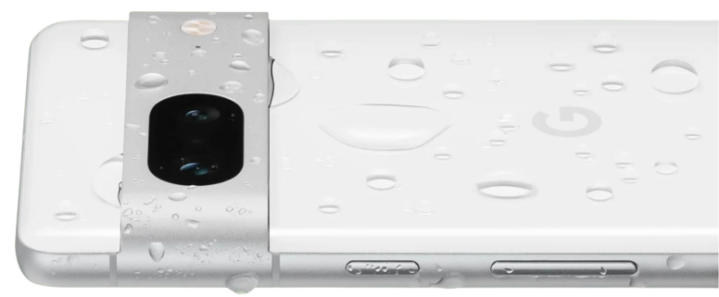
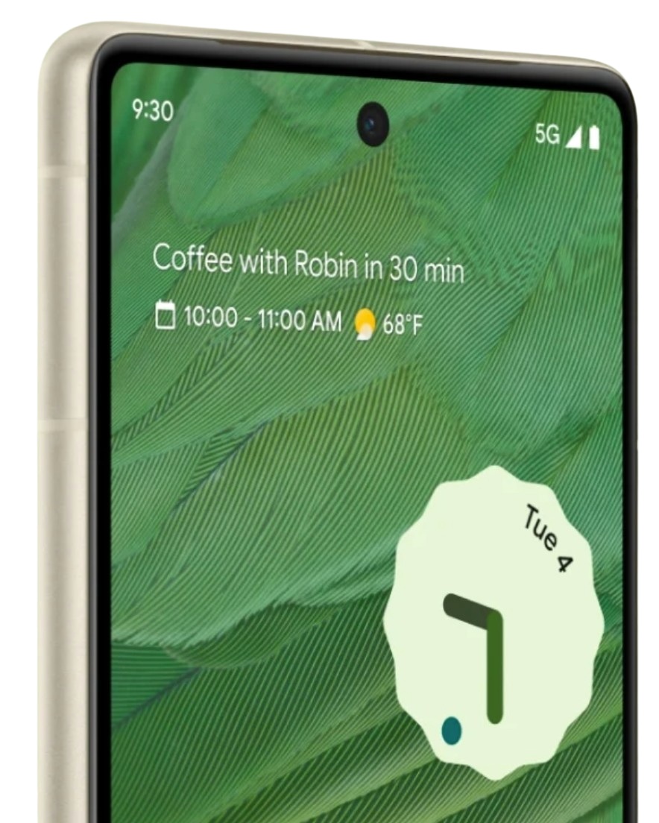
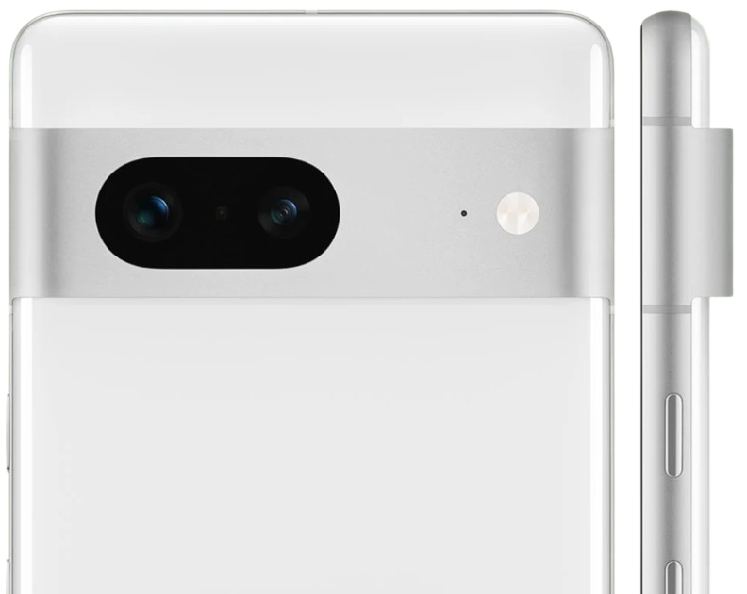
Matte enclosure made from 100% recycled aluminum
fast and responsive display
25% brighter outdoors, even in sunlight

Slide 9
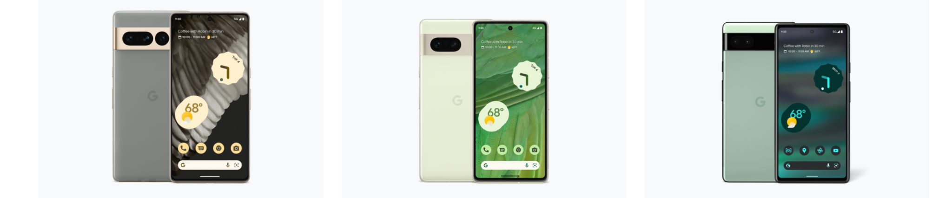
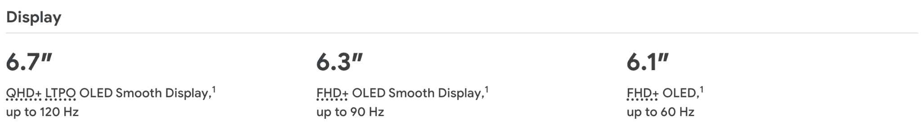
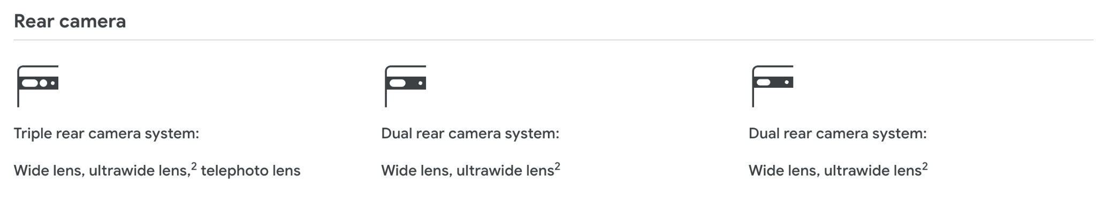
OURPHONE
Y
X
A

Slide 10
THE SPECS
OURPHONE Y
OURPHONE X
OURPHONE A
• Screen: 6.71-inches 1440x3120 OLED
Corning Gorilla Glass
• 2 SIM Cards
• Operating system: Graphene OS
• Processor: Google Tensor G2 (4 nm), Octa-core (2x2.85 GHz Cortex-X1 & 2x2.35 GHz Cortex-A76 & 4x1.80 GHz Cortex-A55)
• Cameras: 50 MP wide, Laser Focus, Laser AF, OIS, 48 MP, f/3.5, 104mm
• Battery: 4410 mAh ???
• Storage: 256 GB, RAM: 12 GB
• Weight: 178 g ???
• Water resistance: IP67
• Screen: 6.3-inches 1440x3120 OLED
Corning Gorilla Glass
• 2 SIM Cards
• Operating system: Graphene OS
• Processor: Google Tensor G2 (4 nm), Octa-core (2x2.85 GHz Cortex-X1 & 2x2.35 GHz, Cortex-A76 & 4x1.80 GHz Cortex-A55)
• Cameras: 50 MP wide, Laser Focus, Laser AF, OIS, 48 MP, f/3.5, 104mm
• Battery: 4410 mAh ???
• Storage: 256 GB, RAM: 12 GB
• Weight: 178 g ???
• Water resistance: IP67
• Screen size: 6.1-inches 1080 x 2400 OLED
• Resolution: FHD+ (1080 x 2400 pixels) OLED
• Operating system: Android 12
• Processor: Google Tensor
• Cameras: 12.2 MP wide, 12 MP ultra-wide, 8MP selfie
• Battery: 4410 mAh
• Storage: 128 GB, RAM: 6 GB
• Weight: 178 g
• Water resistance: IP67

Slide 11
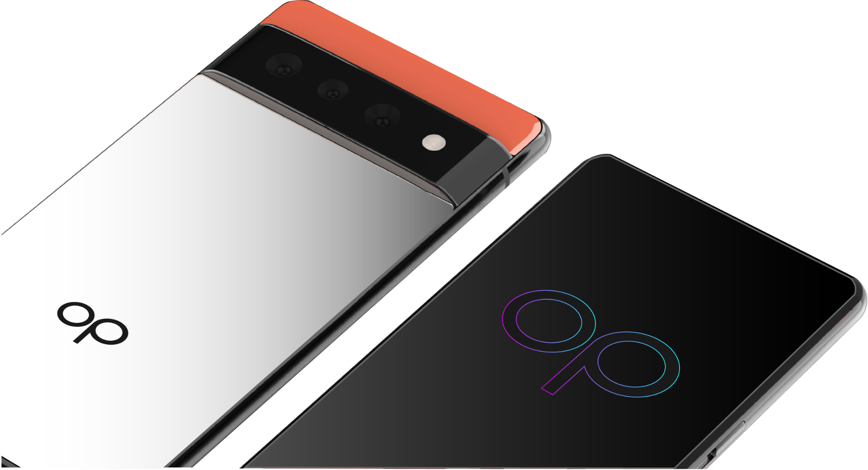
TRANSPARENT PRICING
PRE-SALE
OURPHONE HW A/X/Y
USD 300 … 899 (*) OURPHONE PLATFORM
SETUP: 240 USD MONTHLY: 20 USD (first 6 months free)
(*) We do our best to acquire the phone as cost effective as possible. Your cost will be our cost (hardware, logistics, transport).
You can even buy the phone yourself and we provide our installer.

Slide 12
TOGETHER
a new internet needs to be created together.
PRESALE STARTS CHRISTMAS MINIMAL NR OF PHONES = 1,000
COMMUNITY DEVELOPMENT BUILD
3 months after conclusion of pre-sale.
For developers & Partners
Help us develop.
Preview of features
GENERIC AUDIENCE
goal: 6 months after pre-sale

Slide 13
CROWD FUNDED
Contact us if you want to co-own the OurPhone Company
OurPhone Company is
40% community (crowd funding)
40% threefold (technology provider)
20% team
333,000 shares, 1 share = price of 1 gram of gold = today 58 USD Min shares to acquire = 999. Investors have priority on exit. Each share will be on a blockchain as security token. The OurPhone treasury (funds) are all kept as gold.

Slide 14
PROTECT YOUR WEALTH
Finance our stock of phones & 3nodes (in UAE).
We want to acquire 2m USD worth of phones and compute/storage devices (to build infrastructure). Your investment is backed by the stock. Is structured as convertible loan (5%).
Additional advantage, your financing of OurPhone stock gives you 50% discount in our crowd funding for the amount financed. e.g if you invest 100,000 USD in for ourphone stock you can buy another 100,000 USD worth of shares at 50% discount.

Slide 15




THE MOST SOVEREIGN PHONE IN THE WORLD.
POWERED BY THREEFOLD

Slide 16
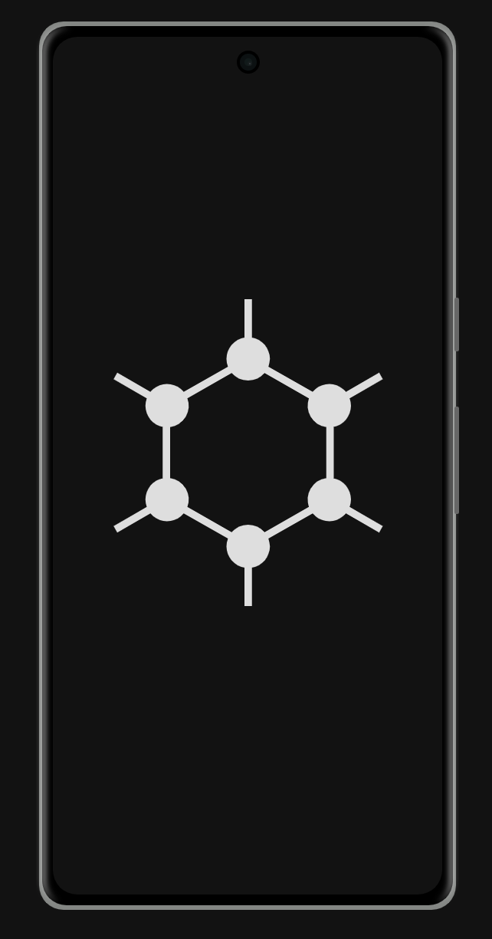
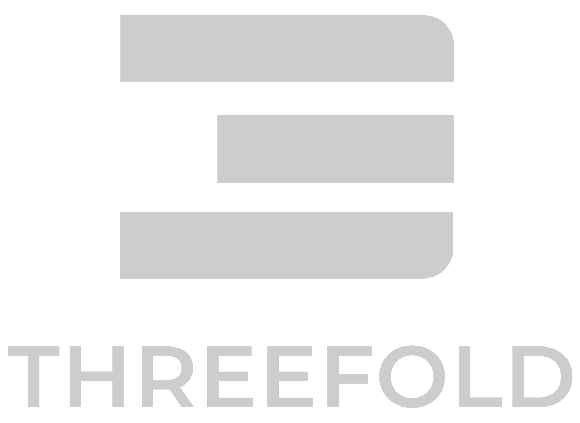
OURVERSE
ALTERNATIVES FOR WHATSAPP, GMAIL, OFFICE365, TWITTER, YOUTUBE, SOUNDCLOUD, ZOOM, … BASED ON PROVEN OPENSOURCE FEDIVERSE PROJECTS (+60,000,000 users today)
OURVERSE APPS
GRAPHENE OS
SECURE OPENSOURCE OPERATING SYSTEM INTEGRATED AND CUSTOMIZED BY OURPHONE TEAM.
THREEFOLD DECENTRALIZED INTERNET
QUANTUM SAFE STORAGE SYSTEM PLANETARY SECURE NETWORK EDGE COMPUTE CLOUD
BE YOUR INTERNET

Slide 17
GRAPHENE OS
The private and secure mobile operating system with Android app compatibility. Developed as a non-profit open source project.
ThreeFold provides the Ourverse Application Platform running on top of the decentralized ThreeFold Grid. Have access to a full sovereign private internet life.
No Google Apps or Play services inside. It's possible to install android apps via our sandboxed Google Play compatibility layer. BE YOUR INTERNET

Slide 18
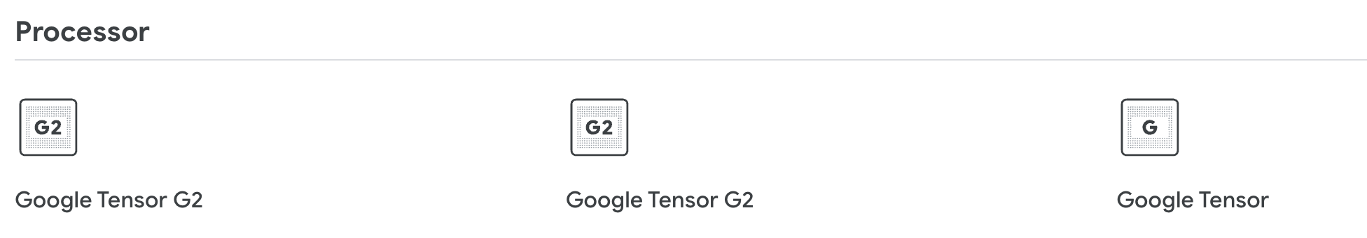
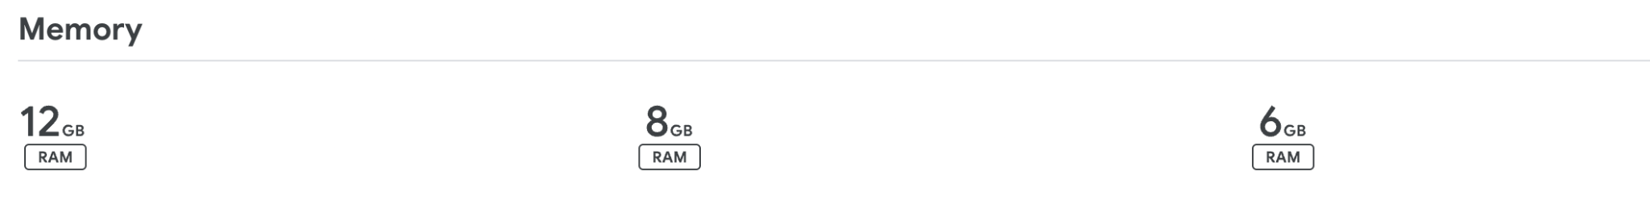
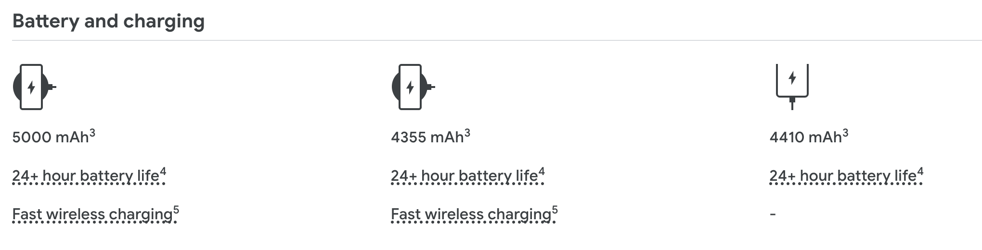
Y
X
A

